Slide 1


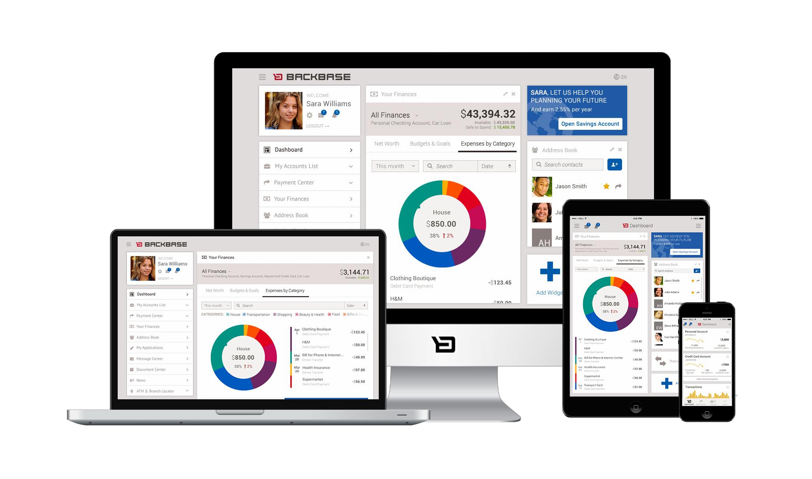
Portal APIs
Focus Area: Foundation

Slide 2
Training Overview
Group Workshop
Back-end
Front-end
Services Integration
Content Services
Advanced Security
Overview
Widget Development
Template Development
Targeting
Publishing
Portal Client
ICE
Foundation
Portal Essentials
Portal Technologies
Portal Tools
Portal APIs
2

Slide 3
Objectives
Foundational knowledge of APIs
Understanding the REST API
Awareness of the Java API
Awareness of the client API

Slide 4


Introduction
Portal APIs
4

Slide 5
API = Application Programming Interface
Introduction
A specification intended to be used as an interface by software
components to communicate with each other
An API may include specifications for routines, data structures, object classes, and variables
An API can be:
language dependent (e.g. Java, Javascript…)
language independent
Can be called from several programming languages
Service-oriented APIs (REST, SOAP)

Slide 6
CXP APIs
Language independent API
Backbase Client
Client Side Logic
Portal Manager
Other REST Clients
Backbase Client API
Portal Explorer
REST API
Java API
Server Side Logic
Portal Server
Language dependent APIs

Slide 7

REST API
Portal APIs
7

Slide 8
Representational
REST
XML, JSON, HTML…
State
More concerned with state of resource than with actions
Transfer
Transferring resource data in some representational form

Slide 9
Architectural style, resource-centered
REST
Compare to service-centered style
Key principles:
Give every item an ID (URL)
Link items together
Use standard methods
HTTP: POST, GET, PUT, DELETE
Resources can have multiple representations
Stateless communication
Server should not have to retain communication state for any of
it’s clients beyond a single request

Slide 10
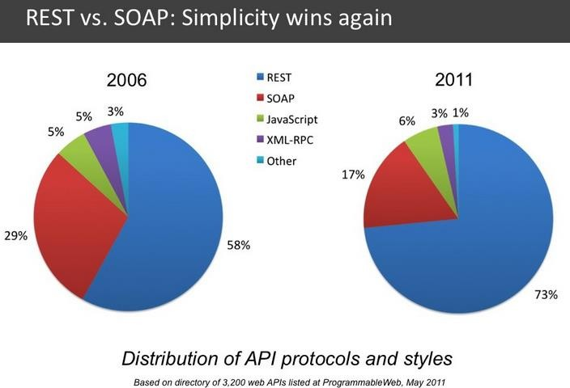
REST API – Simple, Effective (Lean)

Slide 11
CXP REST API
▪ CXP Manager and CXP Explorer are tools that work over the REST API
▪Manipulate model
▪portals, pages, containers, widgets
▪Administrate users, groups and roles
▪ Single data definition shared by server and client: XSD
▪ CRUD operations (create, read, update,
delete), sorting, filtering, paging

Slide 12
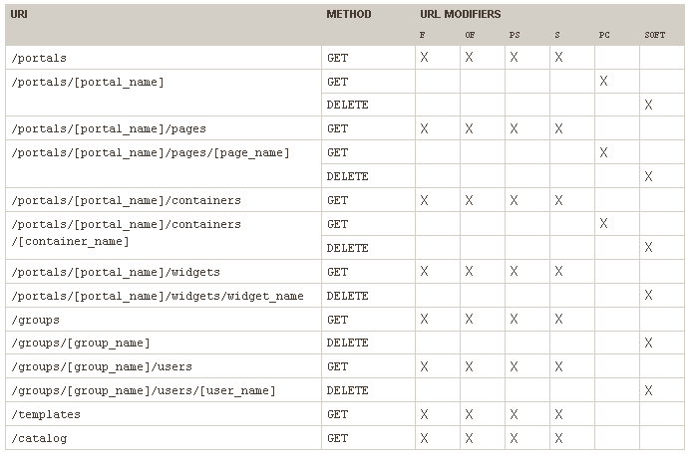
REST API – Syntax

Slide 13
REST API: URL Modifiers
▪It is possible to run REST API queries about items specifying modifiers and parameters
▪ Types of modifiers:
▪Filter queries (f)
▪ Sorting (s)
▪Paging (ps, of)
▪Processing children (pc, depth)

Slide 14
▪Filter queries (f)
REST API: URL Modifiers - Filter
▪ The following syntax is supported:
?f=element_name(operator)value Filters elements by <name> elements.
?f=property.property_name(operator)value
Filters elements by the value of a property.
▪Available operators: lt, gt, eq, not, like
▪ Example:
/portals?f=property.DefaultLandingPage(eq)index

Slide 15
▪ Sorting (s)
REST API: URL Modifiers - Sorting
Sorts results of queries in either ascending or descending order
The syntax: s=element_name(asc|dsc)
▪asc – (ascending)
▪dsc – (descending)
▪ Example:
/portals/[portal_name]/pages?s=name(asc)

Slide 16
REST API: URL Modifiers - Paging
▪Paging results (ps, of)
▪Paging modifiers allow us to page responses:
▪ps – the number of results in the response. The default page size varies per object.
▪of – the number of results to be skipped
in the response. Defaults to 0.
▪ Example:
/portals/[portal_name]/widgets?of=8&ps=4

Slide 17
▪Processing children (pc, depth)
REST API: URL Modifiers - Children
▪Specify whether the children of an item
will be processed or not:
pc – applies to GET requests on the URLs that process items capable of containing child items. If set to false, the response does not include the object children. Defaults to true.
depth – specifies the number of children levels to be displayed.

Slide 18

Demo: REST API Examples
Returns the list of portals
/portals
Returns the portal model
/portals/{portal_name}.xml
Returns a list of pages from 5 to 10, sorted ascending by name
/portals/{portal_name}/pages.xml?of=5&ps=5
&s=name(asc)

Slide 19
Demo: REST API Representational Formats
An item can be requested in either HTML or XML format, depending on the extension of the request
REST API response formats
•.html
•.xml

Slide 20

Workshop: REST API
Get all the widgets in a Portal
sorted by name
Add another widget instance
20

Slide 21
Demo: Portal Manager Using REST API
Portal Manager uses REST API to
communicate with Portal Server

Slide 22

Java API
Portal APIs
22

Slide 23
https://my.backbase.com/resources/documentatio n/portal/5.5.0.0/refc_apidoc_pfjavadoc.html
Java API
Important business services defined in
com.backbase.portal.foundation.business.service
Used in custom server logic (e.g. JSP templates)
instead of the REST API
Internally used by the REST API

Slide 24
Package com.backbase.portal.foundation.business.service
Java API – Important Interface/Classes
PortalBusinessService
GroupBusinessService
ItemBusinessService
▪Instances created by portal server as beans:
@Autowired private ItemBusinessService<Item> itemBusinessService;
or
HttpServletRequest req = (HttpServletRequest) pageContext.getRequest(); ApplicationContext cxt = RequestContextUtils.getWebApplicationContext(req);
ItemBusinessService<Item> itemService = cxt.getBean("itemBusinessService",ItemBusinessService.class);

Slide 25

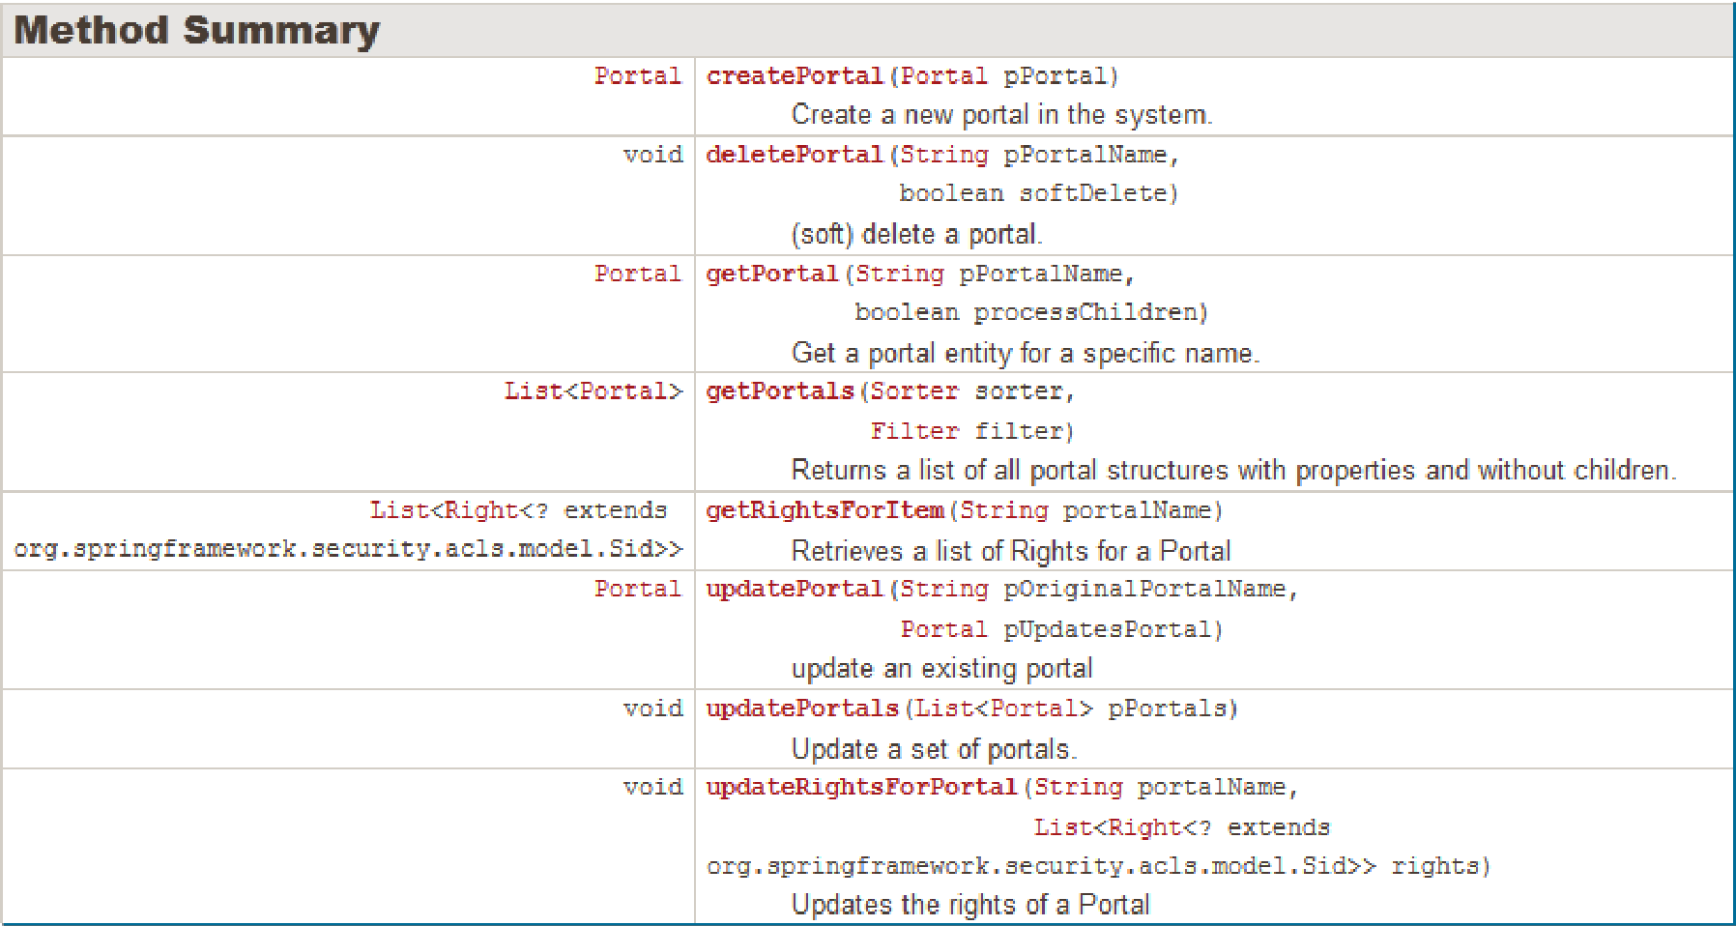
Java API – PortalBusinessService
com.backbase.portal.foundation.business.service

Slide 26

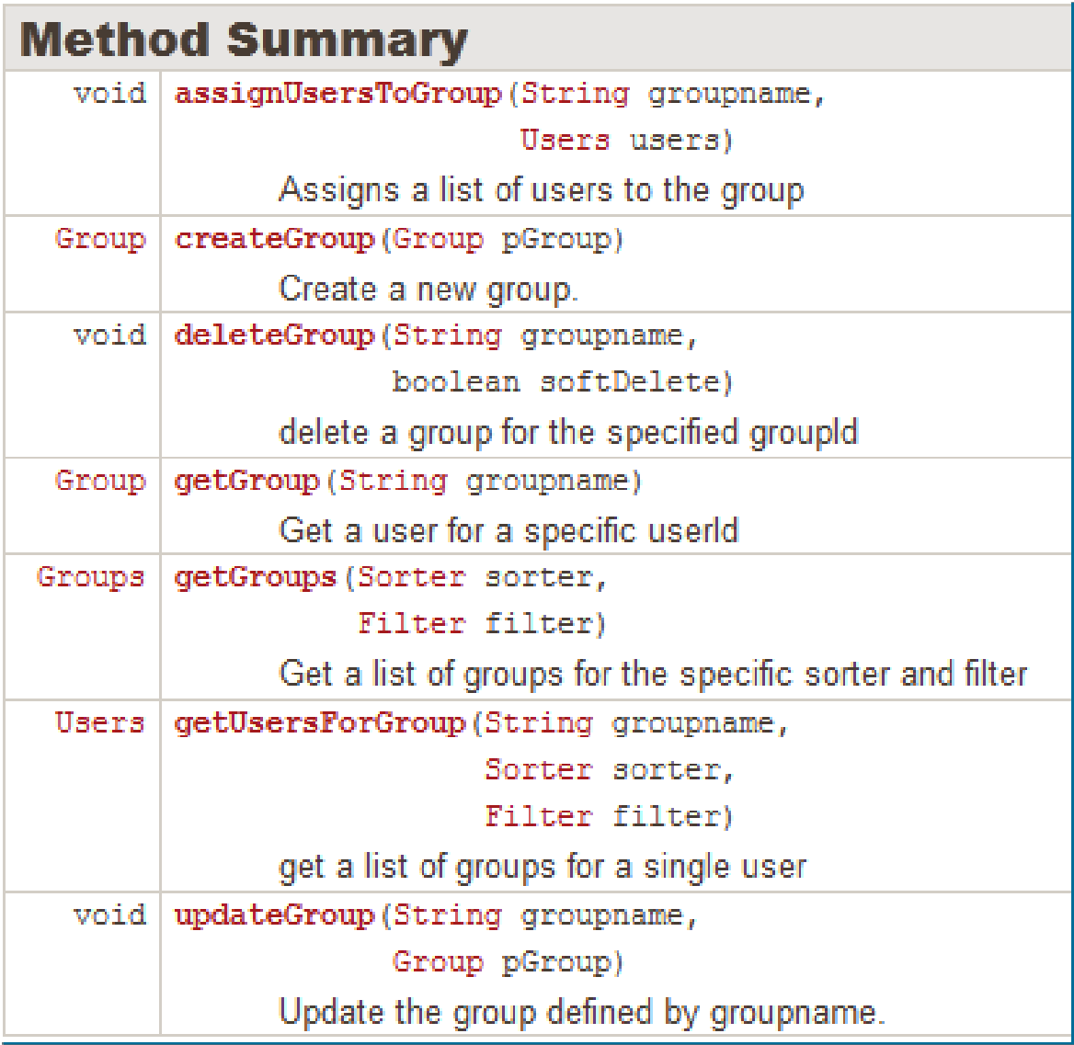
Java API – GroupBusinessService
com.backbase.portal.foundation.business.service

Slide 27

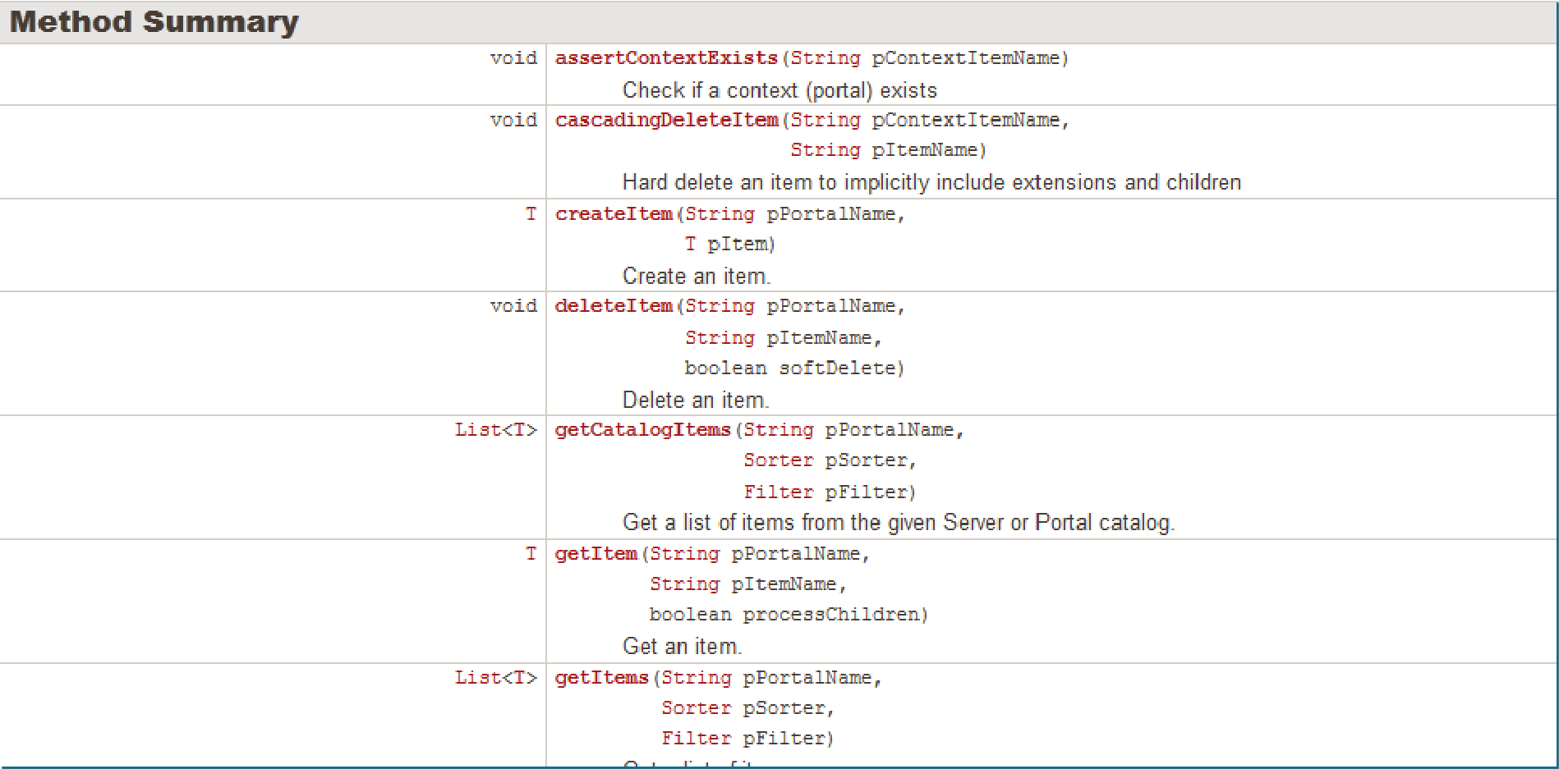
Java API – ItemBusinessService
com.backbase.portal.foundation.business.service

Slide 28

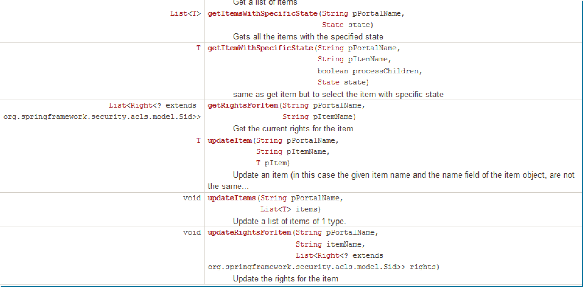
Java API – ItemBusinessService
com.backbase.portal.foundation.business.service

Slide 29
Java API - Events
CXP will notify listeners of many important events:
AddGroupsToUserEvent
AssignUsersToGroupEvent
BeforeServerSideRenderingEvent
BeforeURLCacheResponseEvent
ContentEvent
CreateContentEvent
CreateGroupEvent
CreateItemEvent
CreateUserEvent
DeleteContentEvent
DeleteGroupEvent
DeleteItemEvent
DeleteUserEvent
GroupEvent
GroupUserEvent
ItemCollectionTransformedEvent
ItemEvent
NonAuditableItemUpdateEvent
PublishingApproveEvent
PublishingCreateSetEvent
PublishingEvent
PublishingFailEvent
PublishingRejectEvent
PublishingUnlockEvent
RemoveAllUsersFromGroupEvent
RemoveUserFromGroupEvent
UpdateContentEvent
UpdateGroupEvent
UpdateItemEvent
UpdateItemListEvent
UpdateItemRightsEvent
UpdateUserEvent
UrlLevelCacheRemovalEvent
UserEvent
29

Slide 30

JavaScript API
Portal APIs
30

Slide 31
Javascript API
Javascript API is a Javascript wrapper around the REST API

Slide 32
Points to Remember
Language dependent and
language independent APIs
REST API
Java API
Client API

Slide 33
Thank you!
www.backbase.com
sales-eu@backbase.com
New York: +1 646 478 7538
Amsterdam: +31 20 465 8888
33

